Slide 1
DM TA Session 4
Hanwen Serena Xu
hanwen@uchicago.edu

Slide 2
Contents
Classification
Regression
Questions

Slide 3
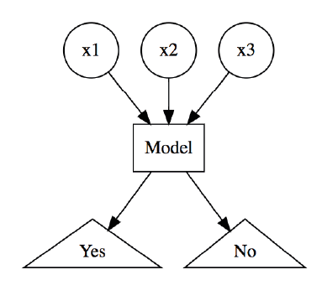
Classification
Objective of classification - predict a categorical outcome (binary or multinomial response)
In classification problems we often face problem of imbalanced labels. Meaning one class labels might dominate the other.

Slide 4
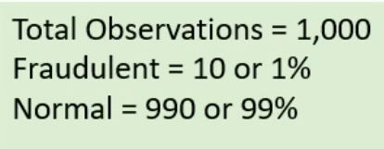
How to deal with imbalanced dataset
Balance the classes by increasing minority or decreasing majority
Random Under-sampling
Random Over-sampling
SMOTE

Slide 5
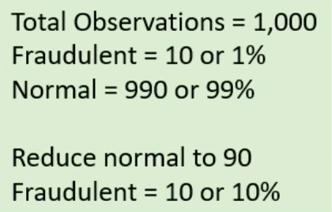
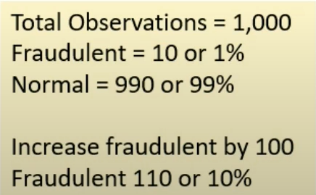
How to deal with imbalanced dataset
Random Under-sampling
Randomly remove majority class observations
Helps balance the dataset
Discarded observations could have important information
May lead to bias
Random Over-sampling
Randomly add more minority observations by replication
No information loss
Prone to overfitting due to copying same information

Slide 6
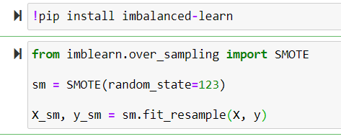
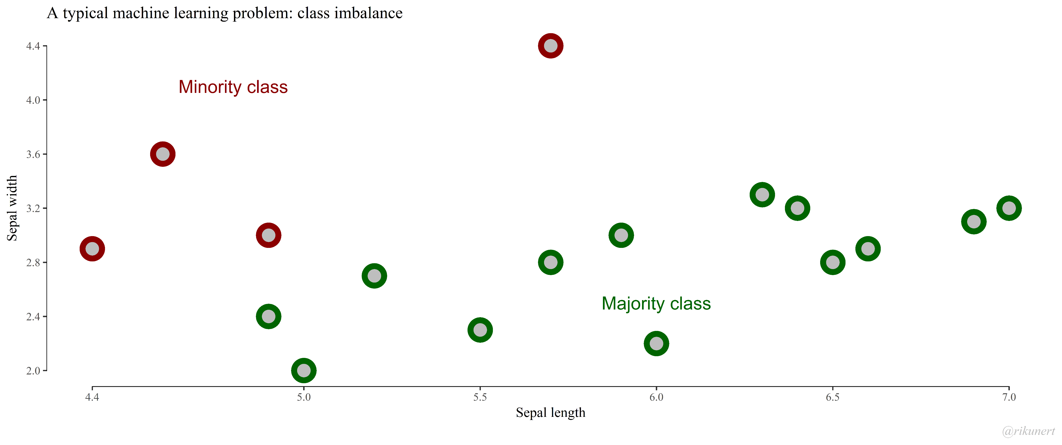
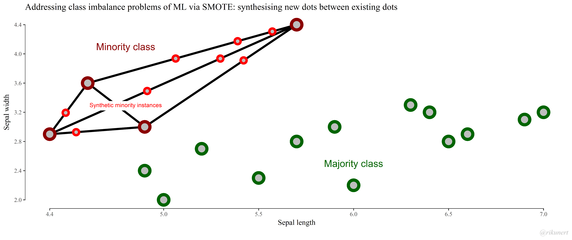
How to deal with imbalanced dataset
SMOTE (Synthetic Minority Oversampling Technique)
Create new “synthetic” observations
There is no absolute advantage of one sampling method over another
Notes:
SMOTE synthesises new minority instances between existing (real) minority instances. Imagine that SMOTE draws lines between existing minority instances like this. SMOTE then imagines new, synthetic minority instances somewhere on these lines.

Slide 7
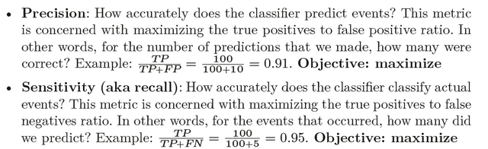
Evaluation
Accuracy
Precision and Recall
Notes:
SMOTE synthesises new minority instances between existing (real) minority instances. Imagine that SMOTE draws lines between existing minority instances like this. SMOTE then imagines new, synthetic minority instances somewhere on these lines.

Slide 8
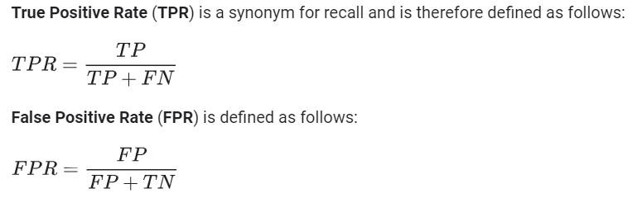
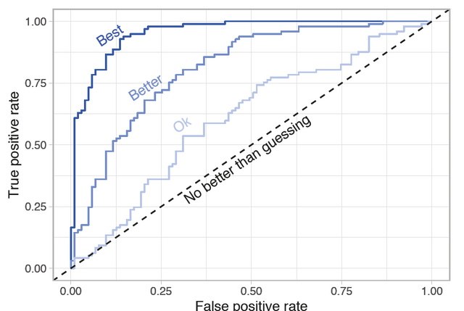
Evaluation
ROC curve (receiver operating characteristic curve)
Notes:
The higher the line is in the upper left hand corner, the better. AUC computes the area under this curve.

Slide 9
Regression
This is a supervised machine learning approach by which we train our model to predict a numerical value.
For eg: Predict the price of a car, given a set of features (mileage, age, brand, etc).

Slide 10
Linear Regression – Assumption:
Multi-collinearity
Linear regression model assumes that there is very little or no multi-collinearity in the data. Basically, multi-collinearity occurs when the independent variables or features have dependency in them.
Relationship between variables
Linear regression model assumes that the relationship between response and feature variables must be linear.

Slide 11
Questions?

Slide 12
Recommended sources
Hands-On Machine Learning with R (Boehmke & Greenwell)
Hands-On Machine Learning with Scikit-Learn, Keras, and TensorFlow: Concepts, Tools, and Techniques to Build Intelligent Systems (Geron)
Applied Predictive Modeling (Johnson & Kuhn)
An Introduction to Statistical Learning: With Applications in R (James et al.)
Business Data Science: Combining Machine Learning and Economics to Optimize, Automate, and Accelerate Business Decisions (Taddy)
The Hundred-Page Machine Learning Book (Burkov)

